Slide 1

Student Performance Prediction Project Synopsis Presentation Date: 12/04/2025
Project (IDS851)
Degree : B.Tech (Data Science) Inurture
Project Guide:
Mr. Dvyanshu Saxena
Mr. Ajay Rastogi
Ali Faiz (TCA2166003)
Priyanshu (TCA2166015)
FACULTY OF ENGINEERING & COMPUTING SCIENCES
TEERTHANKER MAHAVEER UNIVERSITY, MORADABAD

Slide 2

Team Details
Student Name | Role
Ali Faiz | Developer, Testing etc.
Priyanshu | Developer, Testing etc.
Guidelines: Mention Team Names & their role in project
2
T011A/ Template Version 5.0

Slide 3
Project Brief
Student Performance Prediction and Alert System
Project Identification: Clearly state the project's title: 'Student Performance Prediction' for immediate context and project recognition.
Student & Guide Details: Include student names, roll numbers, and the project guide's name to establish project authorship and supervision.
Institutional Affiliation: Specify the course, department, and institute to provide academic context and institutional backing for the project.
Guidelines: Mention brief about the project and it’s functions/ modules
3
T011A/ Template Version 5.0

Slide 4
Project Brief
Problem Statement
Academic Failure Issues: Rising failure rates and student dropouts plague educational institutions, hindering overall academic progress and institutional reputation.
Limited Early Intervention: Absence of proactive systems hinders timely support, causing students to struggle without intervention until it's late.
Manual Tracking Inefficiency: Manual student performance tracking is labor-intensive, prone to errors, and lacks real-time insights for effective intervention.
Guidelines: Mention brief about the project and it’s functions/ modules
4
T011A/ Template Version 5.0

Slide 5
Project Brief
Objectives
Performance Prediction: Employ machine learning to forecast student outcomes based on diverse academic and behavioral data inputs.
Risk Stratification: Categorize students into distinct risk tiers—high, medium, and low—to prioritize interventions based on predictive analysis.
Feedback Integration: Incorporate a dashboard for educators to provide and track feedback, refining prediction accuracy and intervention effectiveness.
Guidelines: Mention brief about the project and it’s functions/ modules
5
T011A/ Template Version 5.0

Slide 6
Methodologies/ Technologies/ Tools to be used
Methodologies
Data Collection & Preprocessing: Gathering diverse academic and behavioral data, cleaning, handling missing values, and feature engineering for ML model readiness.
Model Training & Evaluation: Employing Random Forest, and Logistic Regression; tuning hyperparameters via cross-validation for optimal predictive performance.
Dashboard & Alert Management: Creating user-friendly dashboards for visualizing insights, and implementing customizable alerts for timely intervention based on predictions.
6
T011A/ Template Version 5.0

Slide 7
Methodologies/ Technologies/ Tools to be used
Tools & Technologies
Backend Development: Python is the core language, with pandas, NumPy, scikit-learn, and sqlalchemy managing data, ML, and database interaction.
Frontend Interface: Streamlit creates interactive dashboards for educators, offering real-time visualizations and customizable alerts for student performance tracking.
Database Management: MySQL stores structured student data efficiently, supporting seamless integration with machine learning models for predictive analysis.
7
T011A/ Template Version 5.0

Slide 8
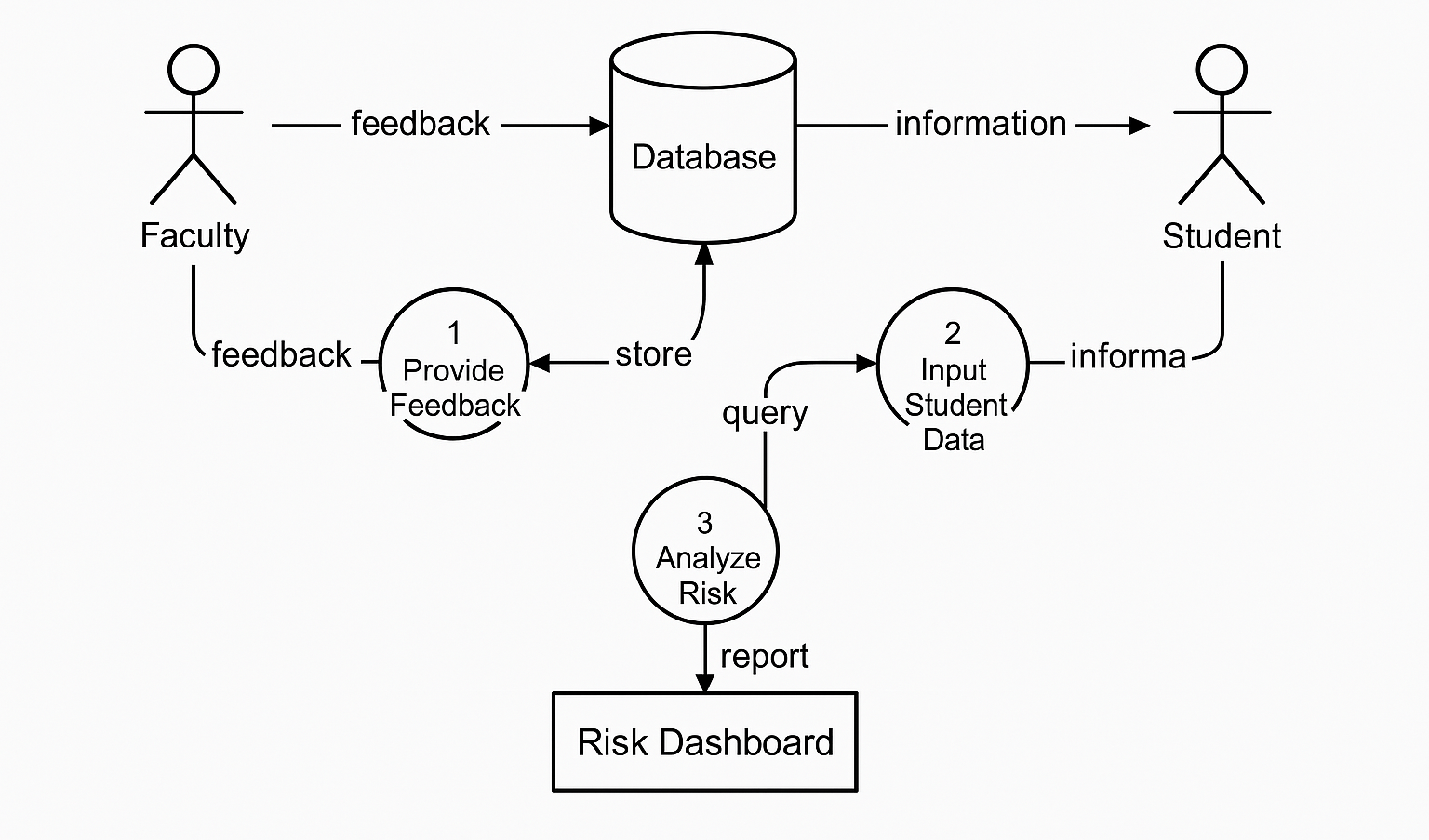
Context Diagram (Overall Project)
8
T011A/ Template Version 5.0

Slide 9
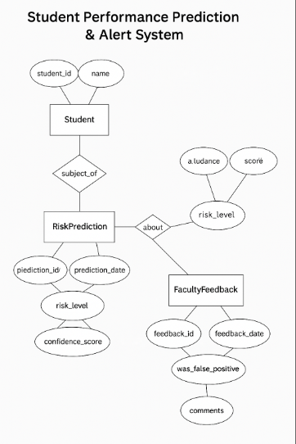
Entity Relationship Diagram (ERD)
9
T011A/ Template Version 5.0

Slide 10
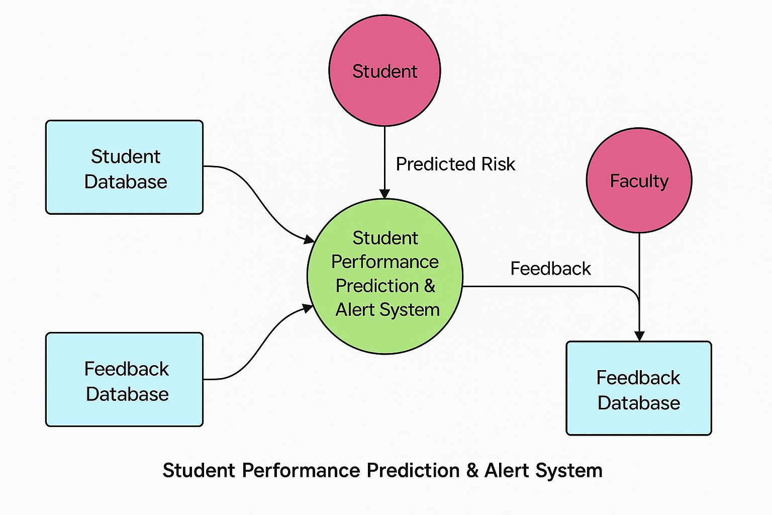
Data Flow Diagram (DFD)
Guidelines: Add more slides, if required to show all DFDs
10
T011A/ Template Version 5.0

Slide 11
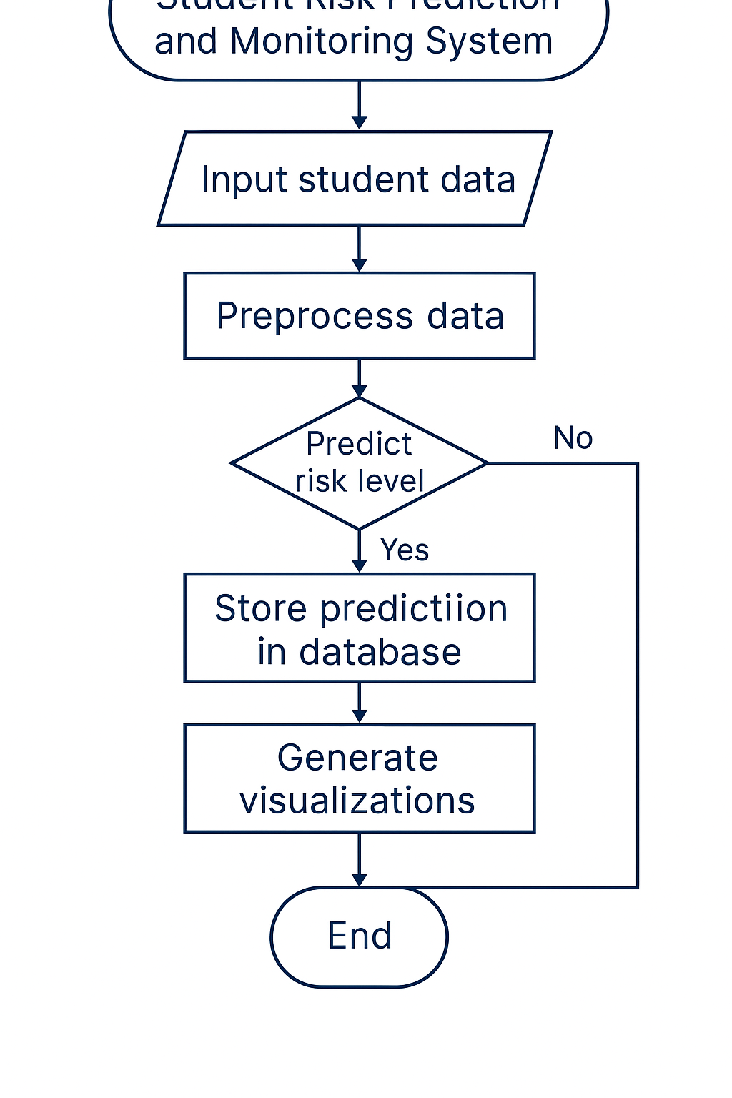
Flow Chart
Student Performance Prediction Synopsis
Guidelines: This slide is optional
11
T011A/ Template Version 5.0

Slide 12
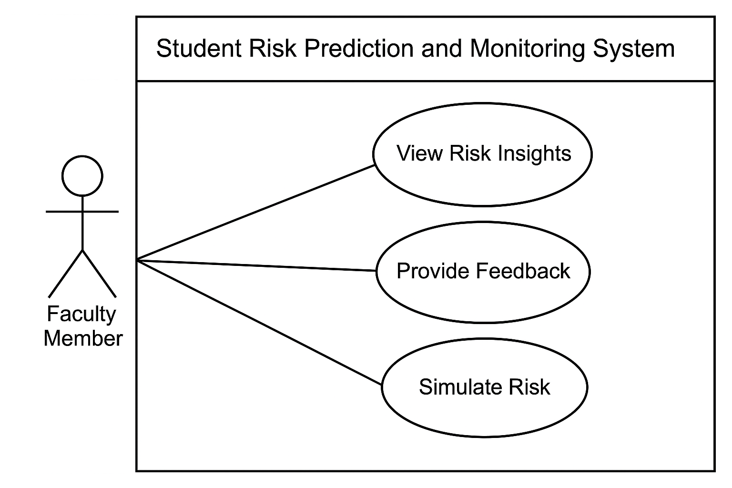
Use Case Diagram
Guidelines: This slide is optional. May add more slide, if the details are available
12
T011A/ Template Version 5.0

Slide 13
\
Advantage of The Project
Proactive Student Support: Enables early identification of at-risk students, facilitating timely interventions and personalized support to improve academic outcomes proactively.
Personalized Feedback Loop: Incorporates faculty feedback to refine predictions, fostering collaboration and tailoring interventions for individual student needs, enhancing support effectiveness.
Data-Driven Decision Making: Provides educators with data-driven insights for informed resource allocation, instructional strategies, and academic policies, enhancing intervention effectiveness.
Guidelines: Mention advantage from this project, the audience/ users who will get benefitted
13
T011A/ Template Version 5.0

Slide 14
References, if any
Books & Articles: Martinez & Phillips' 'Data-Driven Decision Making in Education' explores leveraging data to enhance educational strategies and outcomes.
Websites & Online Resources: EdTech Magazine offers insights on using predictive analytics to improve student outcomes and educational technology applications.
Research Papers: Baker & Inventado's research on Educational Data Mining & Learning Analytics provides a deep dive into data techniques.
14
T011A/ Template Version 5.0

Slide 15
Thanks !
15
T011A/ Template Version 5.0

